Slide 1
Competitive Programming
23 Sep. 2022
Andrei Novikov

Slide 2
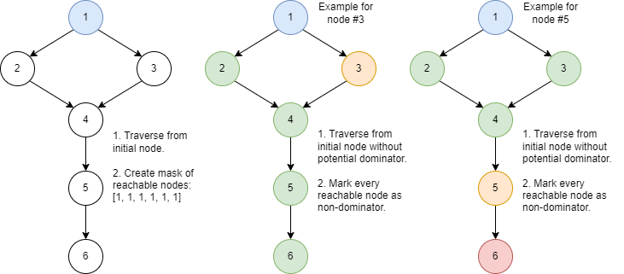
Revise homework #1
Book: “Competitive Programming 3”. Chapter: 4.2.
Task: UVa 11902 – Dominator – Link
Solution: Link

Slide 3
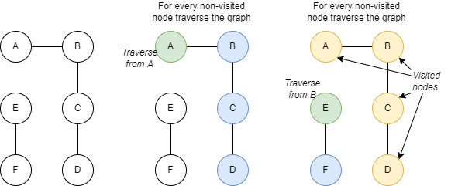
Revise homework #2
Book: “Competitive Programming 3”. Chapter: 4.2.
Task: UVa 459 – Graph Connectivity – Link
Solution: Link

Slide 4
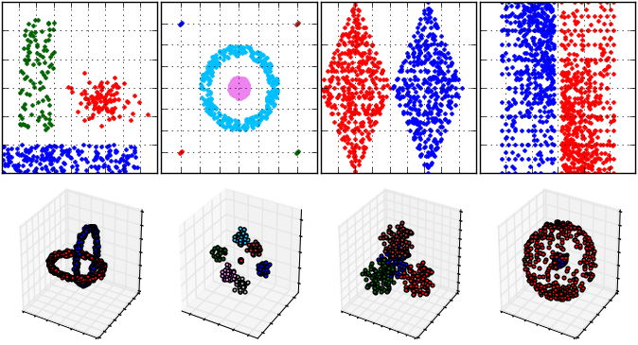
Interesting Fact
Did you know that DBSCAN algorithm is based on the algorithm implemented in UVa 459 (previous slide)?
DBSCAN on various data sets
DBSCAN is one of the clustering algorithms.
Clustering is unsupervised machine learning discipline.

Slide 5
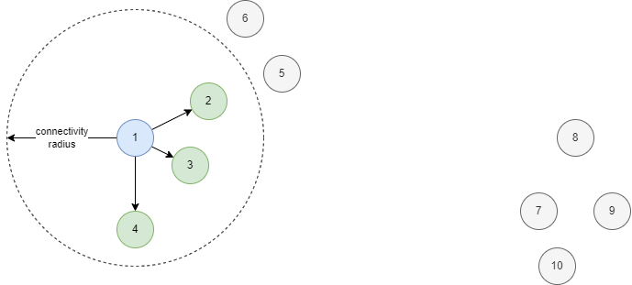
How DBSCAN works – input parameters
There two input parameters of the algorithm:
Connectivity radius;
Minimum number of neighbors;

Slide 6
How DBSCAN works – basic rules
Traverse every non-visited neighbor to discover cluster if it has >= minimum number of neighbors.
Neighbors are defined by the connectivity radius.
If cluster expanding phase:
node has >= min. amount neighbors, then traverse them and assign to the same cluster.
node has < min. amount neighbors, then skip them.
If searching for point to expand cluster:
node has >= min. amount neighbors, then expand cluster from this node.
All nodes that are not assigned to any cluster are considered as outliers.

Slide 7
DBSCAN – Visualization

Slide 8
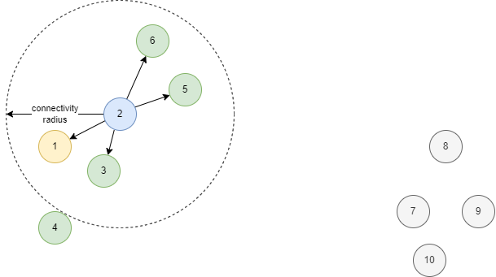
DBSCAN – Visualization

Slide 9
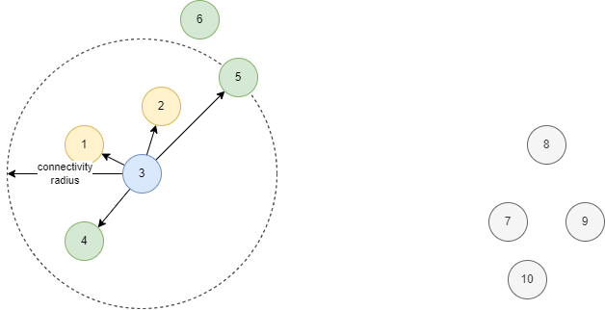
DBSCAN – Visualization

Slide 10
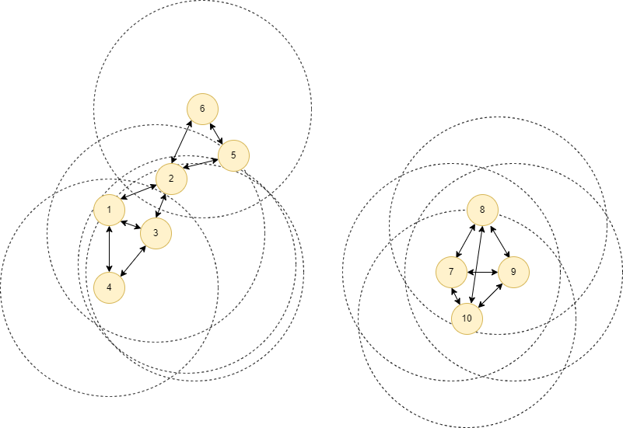
DBSCAN – Visualization

Slide 11
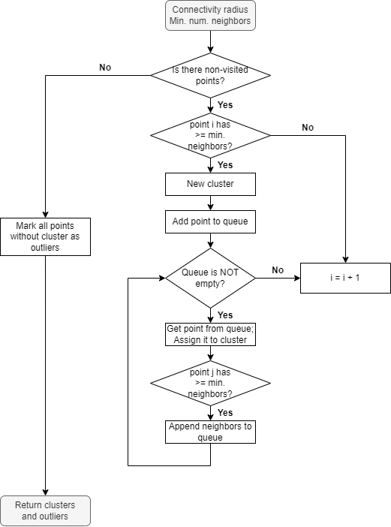
DBSCAN - Algorithm

Slide 12
DBSCAN - Algorithm

Slide 13
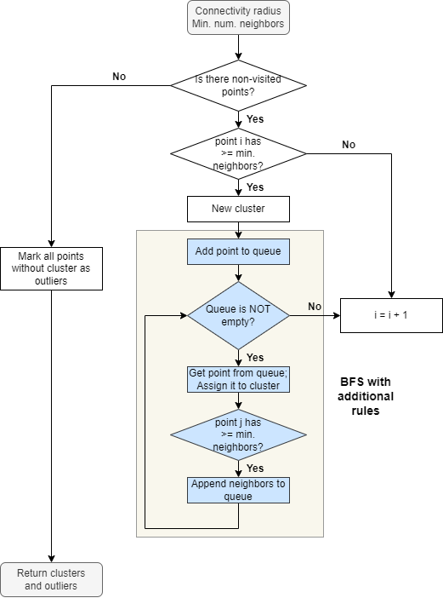
DBSCAN - Algorithm
Basically, the whole task can be considered as UVa 459 with additional restrictions.

Slide 14
DBSCAN - Implementation
Python implementation in pyclustering library: Link
C++ implementation in pyclustering library: Link

Slide 15
Quiz
What is the efficient way to find closest neighbors?

Slide 16
Quiz – Answer
KD-tree.
KD-tree is a binary tree to support distance based problems. The efficient implementation of DBSCAN algorithm uses this tree to find closest neighbors.
KD-tree to find closest neighbors: O(log(N)) – average complexity
Naïve approach to find closest neighbors: O(N)

Slide 17
KD-Tree
Let’s postpone this topic. We are going to investigate it more closely later.

Slide 18
Life Practice – Challenge #1
Topic: Graphs
Resource: Leetcode – 547 Number of Provinces

Slide 19
Life Practice – Challenge #2
Topic: Relax (Others)
Resource: Leetcode – 36 Course Schedule

Slide 20
Home task?
Competitive Programming 3:
4.2.4
4.2.5
4.2.6

Slide 21




Where to Practice
LeetCode [link]
HackerRank [link]
Kattis [link]
TopCoder [link]
Other Resources

